Slide 1

MARKETING Analytics LAB- 1
- Marketing Analytics Lab-1
- Group 6
- Samboju Prakash Tejashwani (ID : 0851199)
- Vikas Sriram (ID : 0857379)
- Darshan Mangukiya (ID : 0857413)
- Nithin Arumbakam Nagaraju (ID: 0852014)
- Oluwaseun Soyinka(0822300)

Slide 2
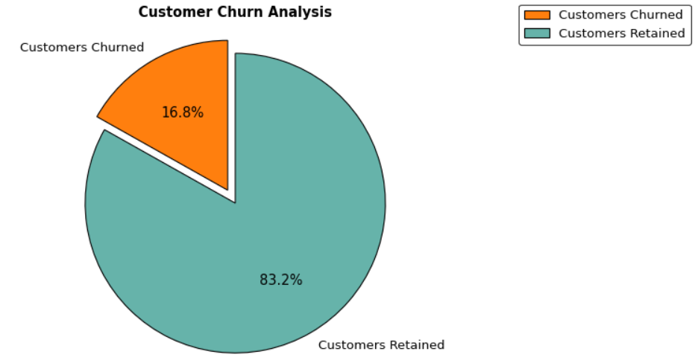
Insight : "16.8% of customers have churned. We need to focus on retaining them."
Recommendation: To maximize customer retention, we will launch an email marketing campaign to gather feedback on our products and services. This campaign will ask customers about any improvements they suggest and their reasons for leaving. Using this feedback, we can make necessary enhancements and offer attractive deals to encourage them to stay.

Slide 3
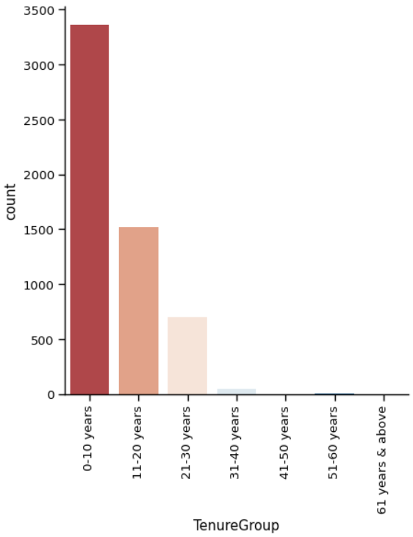
Insight : We noticed that over 25% of customers with a tenure of 0-9 months have left.
Recommendation: We should offer discounts on popular products and services, and provide lower rates on items they’ve bought before.

Slide 4
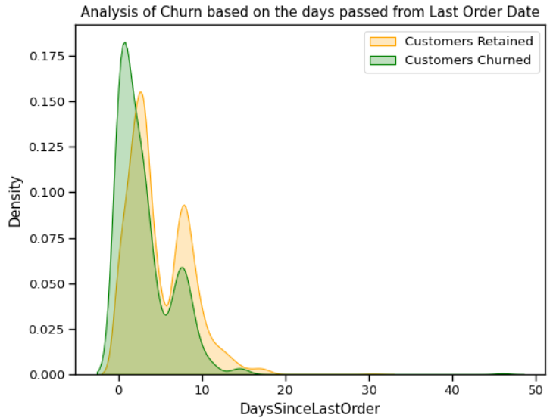
Insight : Over 17.5% of customers have churned shortly after their last order, indicating they might be one-time or seasonal buyers.
Recommendation:We should request feedback on their last purchase and offer seasonal promotions to retain these customers.

Slide 5
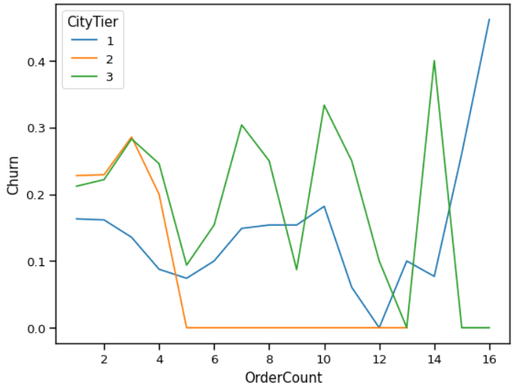
Insight : Despite a high number of orders from both genders in city tiers 1 and 3, there is also a high churn rate in these tiers.
Recommendation: We should analyze past orders for any complaints and conduct surveys with churned customers in these tiers to gather feedback.

Slide 6
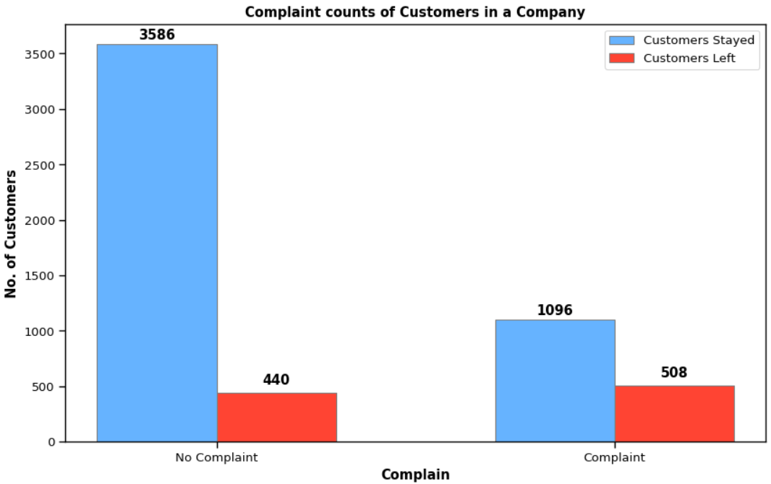
Insight : Our primary focus is that 508 customers who made complaints have churned, along with 440 customers who didn’t have any complaints.
Recommendation: We will prioritize and address the complaints, reaching out to the affected customers to resolve their issues. By rebuilding trust with improved results and offering attractive deals, we aim to retain these customers.

